Slide 1
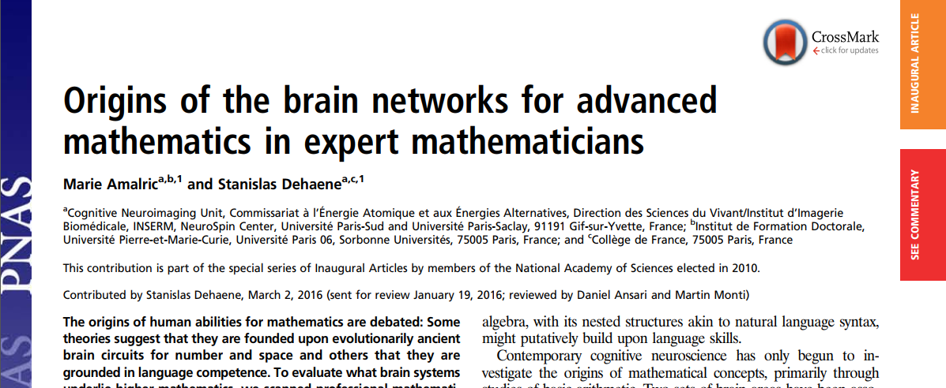
IF = 11.205；SCIE
JCR Q1；中科院综合1区Top
吴俊杰
2022年3月27日

Slide 2
Main Authors
﻿Marie Amalric
（玛丽·阿马里克）
﻿Post-doc
Harvard University
﻿Stanislas Dehaene
（斯坦尼斯拉斯·迪昂）
Prof.，法国科学院院士
Collège de France
how the human brain learns, represents, and manipulates abstract mathematical concepts.
阅读、计算、推理、意识

Slide 3
Research gap
﻿The origins of human abilities for mathematics are debated:
evolutionarily ancient brain circuits for number and space (﻿Dehaene, 2011; ﻿Dillon et al., 2013 ).
language competence (i.e., ﻿Chomsky, 2006).
﻿However, number concepts are too simple to be representative of advanced mathematics.

Slide 4
Main Methods
Participants
15 ﻿professional mathematicians
﻿15 were humanities specialists
Tasks in MRI
Math meaningful (True or False): ﻿A finite left-invariant measure over a compact group is bi-invariant.
﻿Non-Math (True or False): in ancient Greece, a citizen who could not pay his debts was made a slave.
Math meaningless: In finite measure, the series expansion of the roots of a holomorphic map is reflexive.
Non-Math meaningless: Every indebted green beans have a scientific background.

Slide 5
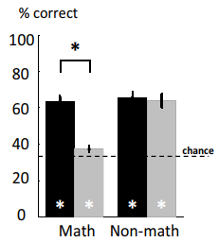
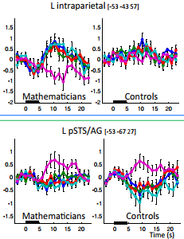
Results
Disassociation for math and language

Slide 6
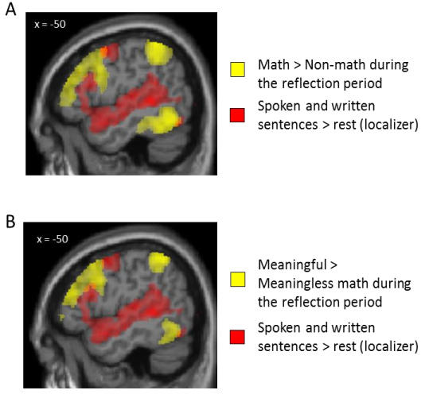
Results
Disassociation for math and language

Slide 7
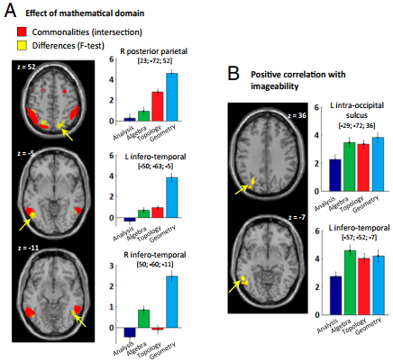
Results
﻿Commonalities of the four mathematical domains

Slide 8
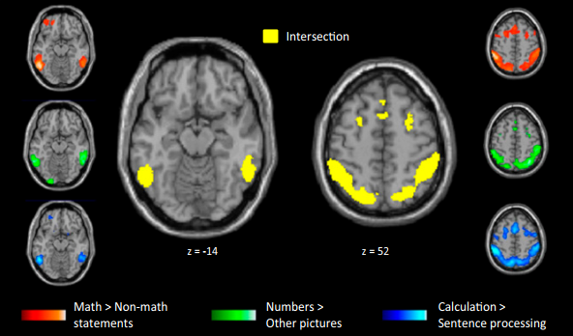
Results
Recruiting regions of basic match for advanced match

Slide 9
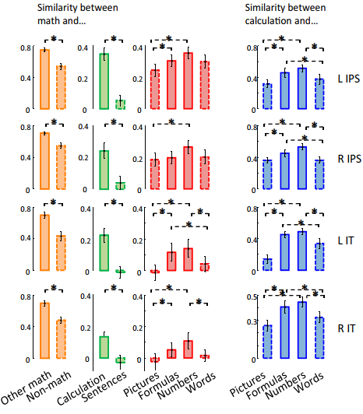
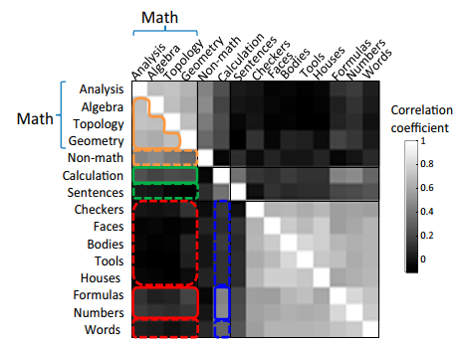
Results
Recruiting regions of basic match for advanced match

Slide 10
Conclusion
﻿Advanced mathematics activated bilateral frontal, Intraparietal, and ventrolateral temporal regions.
These regions are recruited for ﻿basic numbers and formulas in nonmathematicians.
These regions are distinct from regions for language and to general-knowledge semantics.

Slide 11
Further reading
Le Guen, Y., Amalric, M., Pinel, P., Pallier, C., & Frouin, V. (2018). Shared genetic aetiology between cognitive performance and brain activations in language and math tasks. Scientific reports, 8(1), 1-11.
Amalric, M., & Dehaene, S. (2019). A distinct cortical network for mathematical knowledge in the human brain. NeuroImage, 189, 19-31.
Amalric, M., & Cantlon, J. F. (2022). Common Neural Functions during Children's Learning from Naturalistic and Controlled Mathematics Paradigms. Journal of Cognitive Neuroscience, 1-19.

Slide 12
Reflection
如何排除难度的混淆。最简单的数学 vs. 最难的非数学也获得高度相同的结果。
在该研究考察数学加工的基础上，或可进一步考察数学学习，比较不同领域的理解型学习vs.机械式学习。
（理解型 vs. 机械式）for 数学 vs. 汉字。
以回答理解型学习的脑机制是领域特异性的还是领域一般性的。

Slide 13
补充
﻿Reproducible results for easy math vs. difficult non-match

