Slide 1
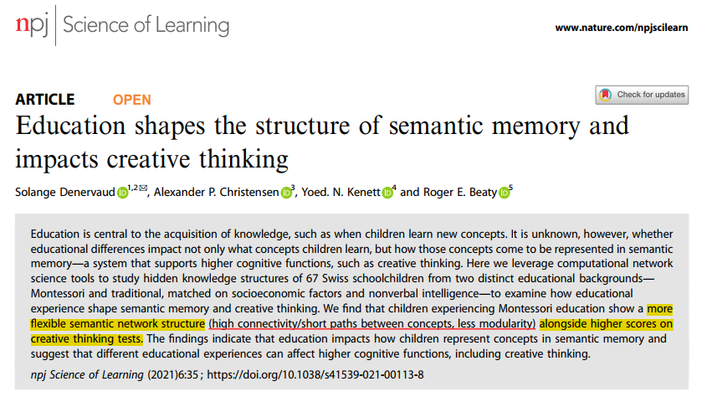
2021
IF = 4.350；SSCI, SCIE
JCR Q1；中科院医学二区
吴俊杰
2022年3月28日

Slide 2
Main Authors
Solange Denervaud
（索朗格·德内尔沃）
﻿PhD/Post-doc
University of Lausanne
Roger E. Beaty
（罗杰·比蒂）
Asst. Prof.
Pennsylvania State University
Cognitive flexibility and creativity development
behavior, fNIRS, MRI, and modelization.
Creative thinking
Network analysis, fMRI, tES-fNIRS

Slide 3
Introduction
﻿﻿Early experience is importance for concept learning, especially school education
Montessori﻿
Multi-age classes
﻿Interdisciplinary, discovery-based work
Traditionally
Successively different topics
Learn & memorize concepts
Montessori ﻿vs. Tranditional classes in ﻿higher cognitive functions (e.g., ﻿Besançon et al., 2008; ﻿Denervaud et al., 2019)
better ﻿academic outcomes
socio-emotional learning
divergent and/or convergent creativity

Slide 4
Introduction
﻿﻿﻿﻿Such effects raise questions about fundamental cognitive processes
such as concept learning.
﻿﻿﻿﻿﻿Semantic representation impacts many important cognitive abilities (﻿Gobbo & Chi, 1986)
e.g., creative thinking
by influencing how knowledge is retrieved from memory

Slide 5
Introduction
﻿Paradigm shift in the study of Semantic representation (﻿e.g., Drieger, 2013; ﻿Christensen et al., 2018)
﻿A simple verbal fluency task
﻿ Cognitive network methods
﻿﻿﻿﻿﻿﻿Network science measures
Higher creative individuals show more efficient and flexible network structure (﻿Kenett & Faust, 2019)
Average shortest path length (ASPL)
Global efficiency
Clustering coefficient (CC)
Local efficiency
﻿ Modularity (Q)
Flexibility

Slide 6
Research gap
﻿Summary
Montessori ﻿classes show advantage
Property of semantic network impact higher cognitive functions.
﻿However, it is unknown whether educational differences:
impact what concepts we learn & how concepts represented in semantic memory
and further impact creative thinking

Slide 7
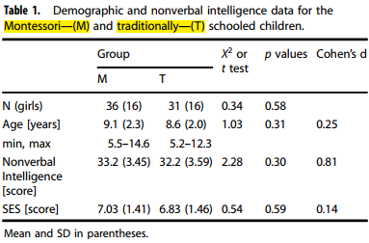
Methods
Participants

Slide 8
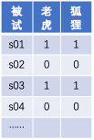
Methods
Tasks
﻿ Verbal fluency
To name as many animals as he/she could in 60 s
﻿ Creativity assessment
﻿Divergent thinking
To draw as many different drawings as possible from one imposed abstract form (i.e., incomplete shape) in 10 min
﻿Convergent thinking
To select 3 different abstract forms out of 8 to create an original drawing that combined them in 15 min
Construct Network

Slide 9
Results
More creative response for Montessori than Traditional Children

Slide 10
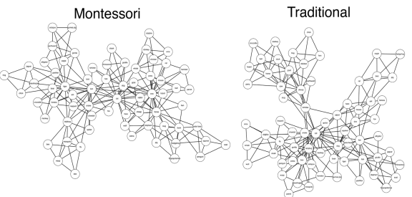
Results
﻿More efficient and flexible semantic network structure
﻿Clustering coefficient
(局部效率)
﻿Average shortest path length
（全局效率）
﻿Modularity
（灵活性）

Slide 11
Discussion
﻿﻿Specific teaching practices found in Montessori classes may foster higher creativity skills
such as the error-and trial approach (children need to solve problems by and for themselves)
the peer-peer tutoring in multi-age classes (higher social diversity, different points of view)
﻿The semantic network and creativity results are consistent with studies in adults (﻿Kenett, 2019; ﻿Kenett et al., 2018)
Efficiency and flexibility of Semantic network -> creativity
Limitations
It is a cross-sectional study
It is unknow that which feature(s) from the Montessori education help(s)

Slide 12
Conclusion
﻿Education impacts how children represent concepts in semantic memory.
Different educational experiences can affect higher cognitive functions, including creative thinking.

Slide 13
Further reading
Li, Y., Kenett, Y. N., Hu, W., & Beaty, R. E. (2021). Flexible semantic network structure supports the production of creative metaphor. Creativity Research Journal, 33(3), 209-223.
Kenett, Y. N., Levy, O., Kenett, D. Y., Stanley, H. E., Faust, M., & Havlin, S. (2018). Flexibility of thought in high creative individuals represented by percolation analysis. Proceedings of the National Academy of Sciences, 115(5), 867-872.
Kenett, Y. N., Betzel, R. F., & Beaty, R. E. (2020). Community structure of the creative brain at rest. Neuroimage, 210, 116578.
Kenett, Y. N., & Faust, M. (2019). A semantic network cartography of the creative mind. Trends in cognitive sciences, 23(4), 271-274.
Beaty, R. E., Chen, Q., Christensen, A. P., Kenett, Y. N., Silvia, P. J., Benedek, M., & Schacter, D. L. (2020). Default network contributions to episodic and semantic processing during divergent creative thinking: A representational similarity analysis. NeuroImage, 209, 116499.

Slide 14
Reflection
相比于传统主观评定两个概念距离的做法，本研究所使用的方法，优点是客观性更高，缺点是只能得到组水平的概念网络。
或许我们也可以增加口语流畅性任务来构建概念网络、增加创造性能力的测试，与脑数据、汉字理解型学习成绩等做关联分析。

