Slide 1
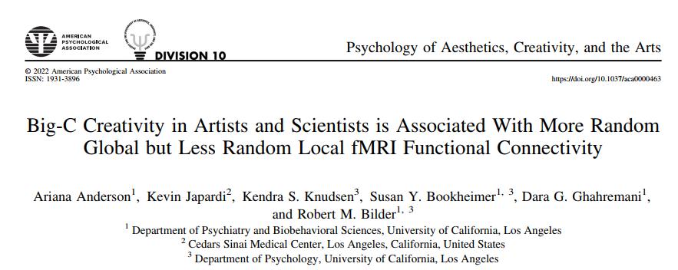
2022
IF = 6.395；SSCI
JCR Q1
吴俊杰
2022年7月19日

Slide 2
Introduction
Creative cognition is mediated by balanced engagement of (e.g., Beaty et al., 2019 )
focused/diffuse
convergent/divergent
stabilizing/novelty-biased processing
No consensus about brain mechanism that facilitate creative cognition
coupling of default mode and salience networks (e.g., Beaty et al., 2015; Shi et al., 2018)
efficiency within the default network (Beaty et al. 2016)

Slide 3
Research gap
Most neuroscientific research on creativity involved university students.
Few studies have involved exceptionally creative individuals.

Slide 4
Methods
Participants

Slide 5
Methods
Tasks
﻿ the alternative uses test (AUT)
Which requires participants to propose alternative uses of common objects.
﻿ the remote associates test (RAT)
Which requires participants to identify words that connect to three seemingly unrelated words

Slide 6
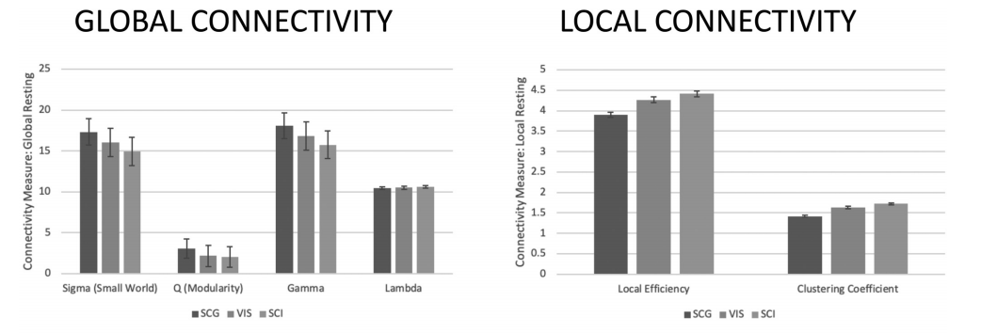
Results
During resting state, greater local efficiency in Big-C than SCG
*
*
*
*

Slide 7
Results
During AUT, less local efficiency in Big-C than SCG.
*
*
*
*

Slide 8
Results
During RAT, no significant difference in Big-C and SCG.

Slide 9
Discussion
Reduced Local efficiency/Less global efficiency enables more widely separated regions connected in the brain to support creative cognition.
No significant functional connectivity differences in the RAT using global or local measures, implying these two groups share differences in the ventral attention network’s functional organization.

Slide 10
Conclusion
Big-C creativity is associated with more “random” rather than more “efficient” global network functional architecture, with condition-dependent variations in local clustering and efficiency.

Slide 11
Reflection
思路与“专家 vs. 新手”的研究是一致的。思路没什么特别创新的地方。
方法也很主流，也没什么特别创新的地方。
结果有点违反传统的“直觉”，但是换个角度去解释又很符合“直觉”。
除了本文的解释角度，我想不出其他它值得发表在这个级别期刊上的理由。

Slide 12
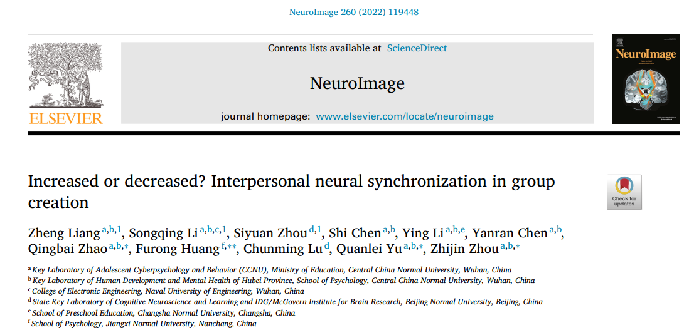
IF = 7.400；SCI
JCR Q1 医学大类 2区TOP
吴俊杰
2022年7月19日

Slide 13
Research gap
Group creation is the process by which group members collaborate to produce novel and useful ideas or products, including ideas generation and evaluation.
However, the interpersonal neural mechanism of group creation during natural communication remains unclear.

Slide 14
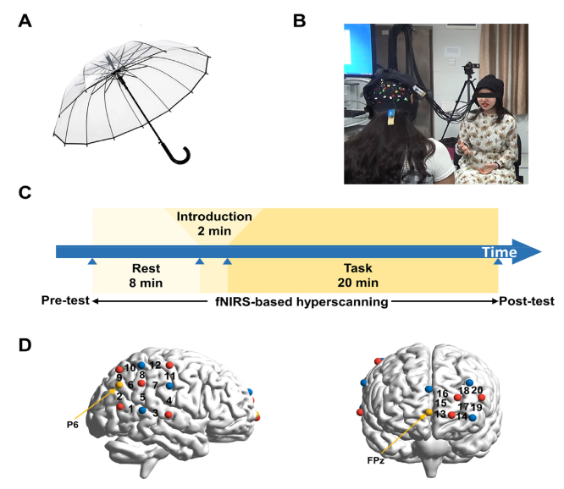
Methods
Product Improvement Task (creative condition)
Item Purchase Plan Task (control condition)

Slide 15
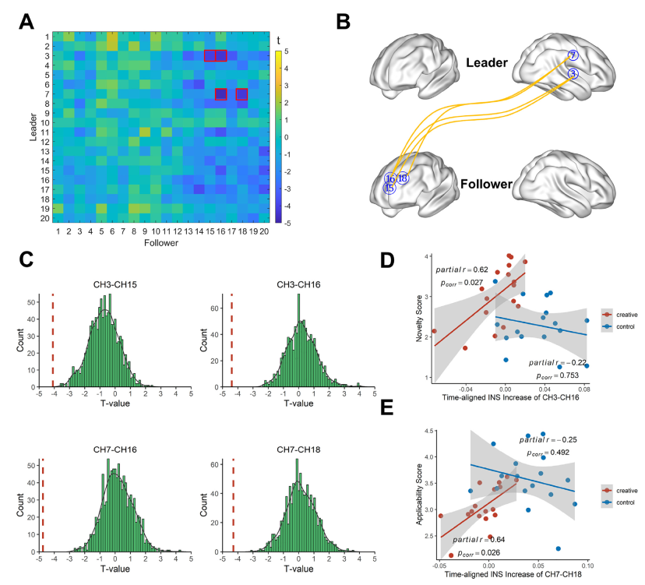
Main Results
SMG
STG
默认网络
执行控制网络
SFG
SFG
MFG

Slide 16
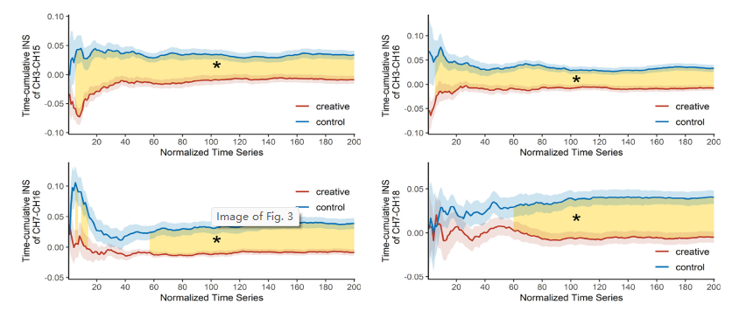
Main Results

Slide 17
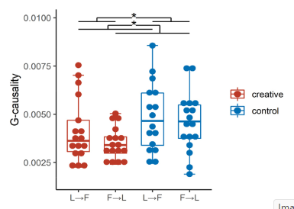
Main Results

Slide 18
Conclusion and implication
The INS in the creative condition was Lower than that in the control condition.
The higher INS, the better performances of group creation.
Lower INS might reflect the creative groups’ conflict of views.
Our findings provide interpersonal neural evidence for group creative interactions in the context of natural communication and increase our understanding of the nature of group creativity.

Slide 19
Reflection
创新的团队，不仅要多想，还要多听。
做法很常规，实验比较自然，实验条件控制很好。
类似的实验设计，可以用于小组合作制作概念地图。
该实验范式，或许可以用于企业的测试，以考察团队的创新能力。

